Slide 1
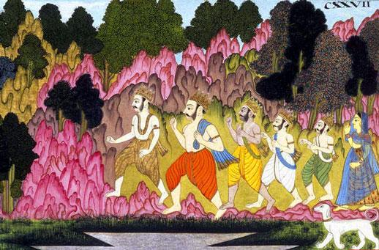
SB 01.15.45-51
The Pandavas Retire Timely

Slide 2
Contents
Kali Yuga civilization will not help
Taking shelter of the Lord's lotus feet
Seeing Krsna face to face
Mahatma Vidura
Flying our own airplane
Becoming dear to Krsna

Slide 3
SB 1.15.45
sarve tam anunirjagmur
bhratarah krta-niscayah
kalinadharma-mitrena
drstva sprstah praja bhuvi
"The younger brothers of Maharaja Yudhisthira obeserved that the Age of Kali has already arrived throughout the world and that the citizens of the kingdom were already affected by irreligious practice. Therefore they decided to follow in the footsteps of their elder brother

Slide 4
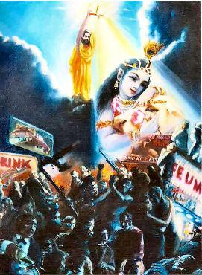
This civilization will not help
kalina adharmena
Kali Yuga : 75% irreligion; 25% religion
Retiring timely from family life
Retirement means no material affairs
Understand the ultimate goal of life
Engage in favorably culturing devotional service of the Lord

Slide 5
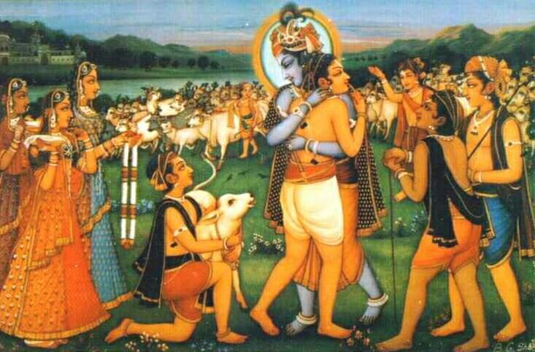
PRACTICAL APPLICATION
Gradually cultivate detachment - Goal is going back home back to Godhead

Slide 6
SB 1.15.46
te sadhu-krta-sarvartha
jnatvatyantikam atmanah
manasa dharayam asur
vaikuntha-caranambujam
"They had all performed all principles of religion and as a result rightly decided that the lotus feet of the Lord Sri Krsna are the supreme goal of all. Therefore they meditated upon His feet without interruption."

Slide 7
Taking shelter of the Lord's Lotus Feet
Pandavas performed Supreme pious work
BG 7.28 : One who performed pious deeds in previous lives and this life become freed from impious acts can concentrate on the Lord's lotus feet
Ultimate goal : vaikuntham caranambujam

Slide 8
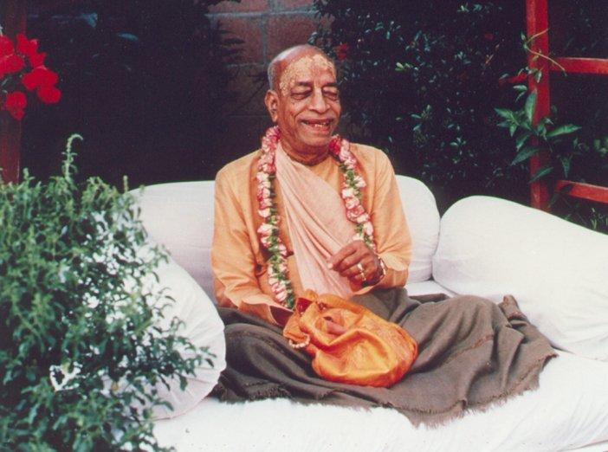
PRACTICAL APPLICATION
Attachment to the lotus feet of the Lord - Practice our life and mould it according to the directions of the pure devotee of the Lord.

Slide 9
SB 1.15.47-48
tad-dhyānodriktayā bhaktyā
viśuddha-dhiṣaṇāḥ pare
tasmin nārāyaṇa-pade
ekānta-matayo gatim
avāpur duravāpāṁ te
asadbhir viṣayātmabhiḥ
vidhūta-kalmaṣā sthānaṁ
virajenātmanaiva hi

Slide 10
SB 1.15.47-48
Thus by pure consciousness due to constant devotional remembrance, they attained the spiritual sky, which is ruled over by the Supreme Nārāyaṇa, Lord Kṛṣṇa. This is attained only by those who meditate upon the one Supreme Lord without deviation. This abode of the Lord Śrī Kṛṣṇa, known as Goloka Vṛndāvana, cannot be attained by persons who are absorbed in the material conception of life. But the Pāṇḍavas, being completely washed of all material contamination, attained that abode in their very same bodies.

Slide 11
Seeing Krsna face to face
Absorbed in the thoughts of Krsna
Get purified by becoming in touch with Krsna always
It is possible to go back home back to Godhead in this very lifetime
One who is situated in transcendence can reach the highest perfection of life without change of body

Slide 12
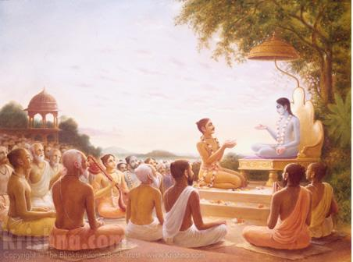
PRACTICAL APPLICATION
Attachment to hearing Krsna Katha, chanting the Holy Names and serving the Vaishnavas.

Slide 13
SB 1.15.49
viduro ’pi parityajya
prabhāse deham ātmanaḥ
kṛṣṇāveśena tac-cittaḥ
pitṛbhiḥ sva-kṣayaṁ yayau
Vidura, while on pilgrimage, left his body at Prabhāsa. Because he was absorbed in thought of Kṛṣṇa, he was received by the denizens of the Pitṛloka planet, where he returned to his original post.

Slide 14
Mahatma Vidura
Vidura left his body and went back to Pitrloka and re-assumed the form of Yamaraja
Yamaraja cursed by Manduka Muni to be born as a sudra
Mahatma Vidura remembered the lotus feet and became washed of all the contaminations of a sudra life
Beauty of Bhakti Yoga system : Think of Krsna and go back to Krsnaloka

Slide 15
SB 1.15.50
draupadī ca tadājñāya
patīnām anapekṣatām
vāsudeve bhagavati
hy ekānta-matir āpa tam
Draupadī also saw that her husbands, without caring for her, were leaving home. She knew well about Lord Vāsudeva, Kṛṣṇa, the Personality of Godhead. Both she and Subhadrā became absorbed in thoughts of Kṛṣṇa and attained the same results as their husbands.

Slide 16
Flying our own airplane
One has to fly his own airplane at the end of life
Help is offered while on ground though
Draupadi was well trained and she at once took shelter of the Lord's lotus feet
anapeksatam - without waiting for anyone and simply depending on Krsna

Slide 17
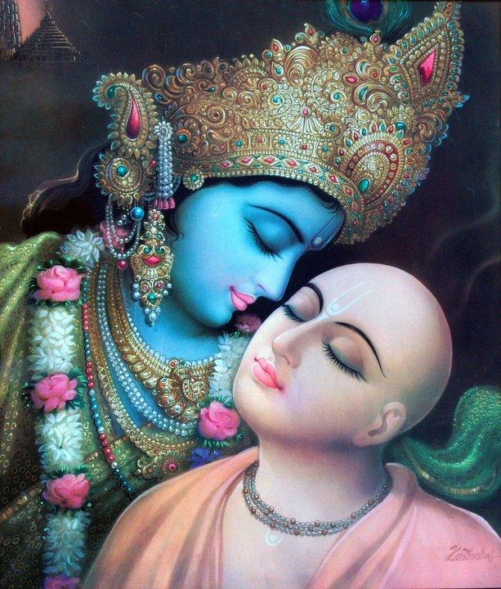
PRACTICAL APPLICATION
ekantha matir apa - Train the mind to simply think about Krsna and His divine pastimes.

Slide 18
SB 1.15.51
yaḥ śraddhayaitad bhagavat-priyāṇāṁ
pāṇḍoḥ sutānām iti samprayāṇam
śṛṇoty alaṁ svastyayanaṁ pavitraṁ
labdhvā harau bhaktim upaiti siddhim
The subject of the departure of the sons of Pāṇḍu for the ultimate goal of life, back to Godhead, is fully auspicious and is perfectly pure. Therefore anyone who hears this narration with devotional faith certainly gains the devotional service of the Lord, the highest perfection of life.

Slide 19
Becoming dear to Krsna
If you love me, love my dog
Worshipping the devotees of the Lord is the best worship
Highest perfection - To become dear to Krsna

Slide 20
PRACTICAL APPLICATION
Constantly hearing and glorifying the devotees of the Lord.

Slide 21
REFERENCES
www.prabhupadavani.org - Lectures on these verses
www.iskcondesiretree.com - Lectures by HH Radhanath Maharaja on these verses

